Slide 1
Budget 2017-18

Slide 2
Agenda – Part 1
Introduction
Council rates and the lower rate environment
Rates and valuations
  How it is calculated
  Analysis
Debt

Slide 3
Agenda – Part 2
Long Term Financial Plan
  Principles used
  Future rate increases factored in
Budget Document
  Operating result v’s underlying operating result
  Capital Works
Challenges facing Cardinia
Questions

Slide 4
Cardinia Shire changing?
With this growth in Population the landscape of the shire is changing, services and infrastructure have had to be significantly upgraded to meet the needs of the continually growing population.
 | 2016 | 2021 | 2036
Population | 95,219 | 117,484 | 180,308
Notes:
Increase est in population is from 2016 to 2036 of 89%

Slide 5
State Government involvement in rates
Property valuations – All valuations are required to be approved by the Valuer Generals Office
Fire Services Property Levy – levy introduced by state government to be collected on behalf of state government via the rating system by Council.
Q. Will my rates increase be in line with CPI for 2017-18?
Yes
Landfill Levy – A rising levy of $63 per tonne of landfilled waste, resulting in additional cost to Council in excess of $1.4M for 2017/18.
Notes:
State Landfill Levy - Risen 590 per cent in four years, up from $9 per tonne in metro areas to $53.20 a tonne ($62.03 for 2016-17)(Source MAV – March 2014Media release)

Slide 6
State Government involvement in rates
Various rebates ie pension rebate, for the period 2000 to 2004 remained fixed at $135. It has increased by CPI since 2004 to $268.30.
Controls via differential rate guidelines as to how Council can implement the rating system.
  State Government prohibits councils in the use of rates, example been the introduction of Gaming Rate – Successful lobbying by Gaming group impacted on state governments decision to remove this rate.

Slide 7
Rating history
Is it true that Council rates have increased well above CPI over the 10 years.
Yes total council rates for Victoria have increased by $2.5 billion over a decade to $4.3 billion.
As a point of reference, we could also consider

Slide 8
Rating history
State property taxes (land tax and stamp duty) rose by $2 billion to $4.8 billion over the same period and the total State tax take has grown by $5.7 billion to $15 billion.
Total Council rate revenue has grown by $2.5m over the decade while state government tax take has significantly increased above this at $5.7m.

Slide 9
State Government involvement in rates
Commonwealth taxes have expanded by $123 billion over 10 years prior to rate capping to $317 billion.
Source MAV – March 2014 Media release

Slide 10
Role of Council
Councils are no longer Roads, Rates and Rubbish.
Council is delivering services now that it did not deliver 10 years ago, while collecting 3.5 cents of every tax dollar raised nationally
(Source MAV – March 2014Media release)
Notes:
We say 3% in budget – external influences but don't know source

Slide 11
Some of the Services Council provide either directly or through subsidies
Food Safety Inspections
Home Care
Maintaining Parks
Planning
Emergency Management
School Crossing
Maternal and Child Health
Public Toilets
Community Health
Community Facilities – Tennis Netball, Bowls etc
Public Lighting
Compliance
Maintaining Sports Field
Local Roads
Community Resiliance
Footpaths
Swimming Pools
Local Halls
Bridges
Buildings Control
Youth Services
Waste Management
Children’s Services – Kinder etc
Strategic Planning

Slide 12
Council rates
Q. Will the quantum of rate increases proposed in councils 5 year plan change as a result?
  Each year the State Government will advise the level of the rate cap which will be implemented across the state.
  Cardinia have factored in current estimates of CPI but this quantum may change based on external factors.
Council is now is a position where its ability to plan into the future has been hindered and has an added variable of uncertainty added to its planning process.

Slide 13
Council rates
Does this mean my rates will increase by only 2%?
  For this year, Yes as it is not a property revaluation year. This will be explained further in Valuations and how rates are calculated section

Slide 14
Valuations
Cardinia uses the Capital Improved Value as the basis for rating purposes.
The Capital Improved Value is the value of the land and any improvements including dwellings, other buildings and landscaping.
The Capital Improved Value is generally considered to be an estimation of the market value of a property as at a date set by the Valuer General.

Slide 15
Frequency of valuations
Municipal valuations, for all properties in Victoria, must now be completed every two years.
Council’s valuation contractor conducts a review of property values based on property sales
The next valuations will occur in 2018/19 and will be based on sales levels as at 1 January 2018.

Slide 16
How are rates calculated
The ‘Rate in the Dollar’
For a council using only a general rate, the rate in the dollar is calculated as follows:
If Council plans to raise total rate revenue of $10 million, and the Capital Improved Value of all rateable properties in the municipality is $2,380 billion, then the rate in the dollar is calculated by dividing $10 million by $2,38 billion = 0.42 cents in the dollar.
Now, the rate in the dollar is set based on prior year plus state government rate increase advised.

Slide 17
How are rates calculated?
The formula for calculating the rates for an individual property is the valuation multiplied by the rate in the dollar. Councils determine the rate in the dollar as part of their budget process.
For example if the Capital Improved Value of a property is $500,000 and the council rate in the dollar is set at 0.42 cents, the rate bill would be ($500,000 x 0.0042) = $2,100.

Slide 18
How are rates calculated?
If Council, in a revaluation year, decided not to increase rate revenue there would still be changes to rates on individual properties.
Yes, they would most likely change

Slide 19
How are rates calculated?
Comment: I am paying more rates in Cardinia than my friend pays in a house worth three times as much in another municipality…
 | Rates payable on average value house 2017/18 | Average house price | Total value of residential land
Cardinia | 1,560.27 | 429,000 | 15,727,905,439
Council X | 1,378.06 | 1,146,000 | 52,166,074,844

Slide 20
Debt
Council debt is managed on an ongoing basis.
Council’s current debt is approx. $55m, in 2008/09 this amount was approx. $45m.
During this period council moved offices and purchased outright the new building and associated parking land.
As part of its last 3 annual budget processes Council adopted the Debt Management Strategy.
Council’s debt level is forecast to reduce from $55m to $46m over the four year period of the plan.

Slide 21
Is Council’s debt manageable?
The Australian Centre of Excellence for Local Government (ACELG) has released in 2014 significant research on local government finance called
  'Debt is Not a Dirty Word: The Role and Use of Debt in Local Government'
The research suggests that the closely managed use of debt by Australian local councils would address infrastructure backlogs and positively support sustainable local communities and organisation performance.

Slide 22
Debt summary

Slide 23
Agenda Part 2

Slide 24
CPI – what is it ?
Primary purpose of the CPI is as a macro–economic indicator of price inflation affecting households.
CPI is intended to measure the overall inflation in prices of goods and services acquired by Australian households.
CPI basket is determined based on a number of factors. Items: must be representative of purchases made by households;
  must have specifically identifiable characteristics that can be observed each period to price to constant quality (e.g. a 420g can of baked beans, or adult general admission to a football game); and
  may be those that some people would exclude on moral or social judgements, for example, tobacco and alcohol products will be included in the basket even though many households may never purchase them.
Source: http://www.abs.gov.au/websitedbs/webfaq.nsf/home/consumer+price+index+faqs#Anchor7

Slide 25
Draft 4 Year Financial Plan
The plan adopted as part of the 2017/18 Budget achieves an underlying operating surplus for the first year only of $14k, with deficits ranging from a peak of ($1.3) million in 2018 -19 to ($85)k, in 2021-21
The budget proposed generates an operating surplus in 2017/18.
Rate increases are factored in at 2% over the life of the plan.
Stable developer contributions are factored in.
No significant increase in Government grants included.
Increase in Materials and Services factored in at between 2% and 4% to allow for growth.
Page 27

Slide 26
Draft 5 Year Financial Plan
Table below shows a comparison with the key assumptions of 2016-17 financial plan (forecast) to the draft budget preparation completed to date as part of the 2017-18 budget process.
 | 2016-17 forecast | 2017-18 Proposed Budget
Council Funded Capital Works | $18.494m | $31.205m
Rate Increase | 2.5% | 2.0%
Underlying Surplus/(Deficit) | ($766k) | $14k

Slide 27
Budgeted Expenditure analysis
Expense Description |  | % of total | Reason
Employee Costs |  | 32.60% | Council Wage growth is as per the EBA. Includes the increase in staff required to deliver council services in a growing area such as Maternal and Child Health.
Material and Services |  | 40.75% | This line represents the costs of services and goods provided to council to deliver the services the community expects. As the Shire grows these costs grow not just by CPI but also by the growth within the shire and the factors such as electricity, water, road materials etc which move in excess of the CPI figure.
Depreciation |  | 21% | Represents the Increase in the asset base of council. Significant movement due increase in valuation on council assets and asssets received from developers.
Finance Costs |  | 3.26% | Movement due to cost of borrowings and debt management
Other Expenses |  | 2% | Due to reallocation to other expense categories in particular Materials and Services

Slide 28
Council cost base – employee costs - Actuals

Slide 29
Rates
1% increase in rates is equal to approx. $690,000
Council has worked over the last number of years to close a significant underlying deficit. A proportion of the rate increase each year was allocated to closing this gap.
The continued growth of the shire and the changing needs of the community for different services places additional pressure on council.
Aging infrastructure outside of the growth area requiring significant replacement/upgrade and maintenance yet unable to access elements of government funding more suited to these infrastructure types

Slide 30
Analysis of rates per assessment – based on 15-16 data
Page 33

Slide 31
Underlying budgeted result
The underlying result represents the true operating result
 | Draft Budget 2017/18 ($’000’s)
Surplus for the Year | 7,664
Less
Capital Related (Cash) | 6,770 | Cash contribution relating to specific capital works
Developers Income (Cash) | 881 | Cash Contribution from developers relating to specific capital works
Underlying result | 14 | Surplus on operations

Slide 32
Underlying budgeted result
The underlying result is in line with the budgeted 2016-17 result.
This balanced result is reasonable given the increase in rates has decreased from 2.5% to 2%

Slide 33
Draft Capital Works 2017-18
Total of Works program for 2017-18 ($44.86m) of which ($34.2) is funded by council, ($16.22m) from Rates Funding.
$165m invested in Capital Works over 5 years of which $116.2m (70%) is funded directly by Council.
Approx 40% of council funded work directed in the renewal sector.
Loan Borrowings to Fund New Major Projects reduce below level of repayments to allow for a reduction on overall debt over the 5 years.
Community grants and Township implementation Funds total $2.74m over 5 years.

Slide 34
Highlights of the Capital Works program are:
New projects totalling $21.5m, including:
  Deep Creek Reserve ($6.8m);
  Lang Lang recreation facility ($3.4m);
  James Bathe Recreation Reserve ($2.7m); and
  Comely Banks children’s facility ($2.0m).
Total expenditure of $23.4m on asset renewal and upgrade, including roads, bridges and buildings, footpaths and drainage replacement, plant and plant replacement, recreation reserves and sporting facilities.

Slide 35
Council Funded Capital Works in SRP

Slide 36
Challenges facing Cardinia
Cost Shifting
Unfunded Liability on Precinct Structure Plans
Continued Development and Growth within the Shire
Access to Government Funding
Potential Future Defined Benefit Call
Cashflow and impact of DCP funds
Page 40
Notes:
Many other challenges, these are just a selection

Slide 37
Planning and Development division

Slide 38
Strategic and Economic development
Strategic Planning
Combined planning scheme amendments and planning permit applications
Review the Cardinia Planning Scheme, particularly the effectiveness of statutory controls
Implement actions outlined in the Municipal Strategic Statement
Process significant planning projects, major applications and environmental effects statement
Preparation of planning policies
Consider and respond to state planning initiatives including review of policies, legislation and the Victorian Planning Provisions

Slide 39
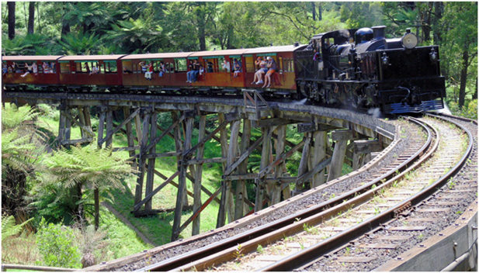
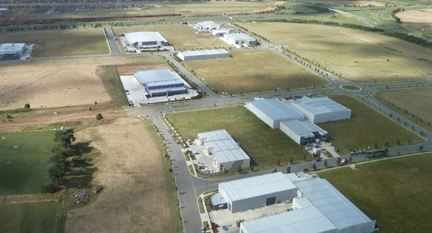
Strategic and Economic development
Economic Development
Investment attraction & Employment generation
Facilitate the growth of local businesses
Foster a culture of entrepreneurship
Maintain a strong agribusiness sector
Build leadership in the business community
Build a connected economy with many types of businesses
Continue to promote the Casey-Cardinia region
Committee for Gippsland (C4G)

Slide 40
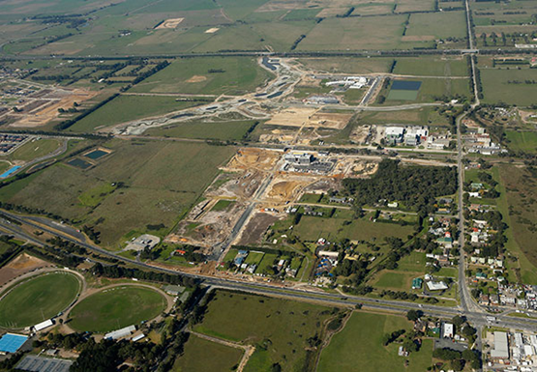
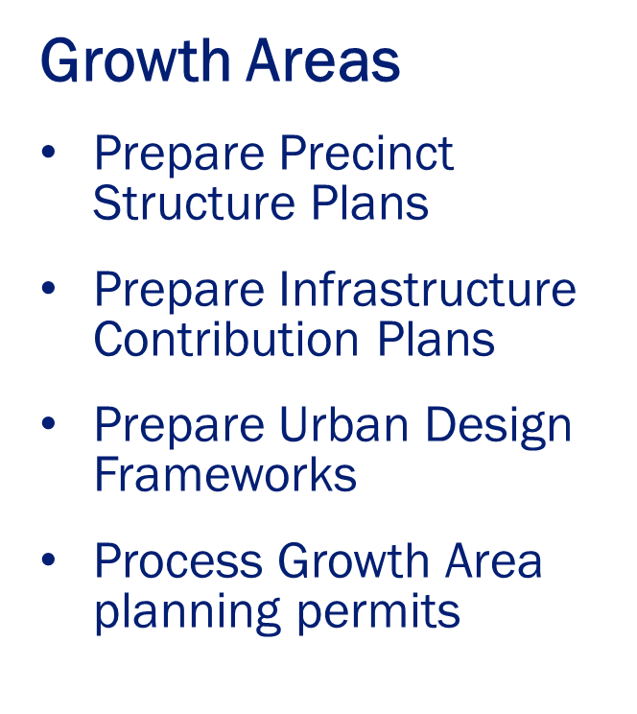
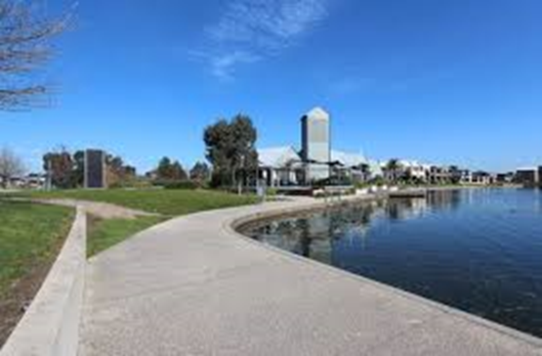
Strategic and Economic development

Slide 41
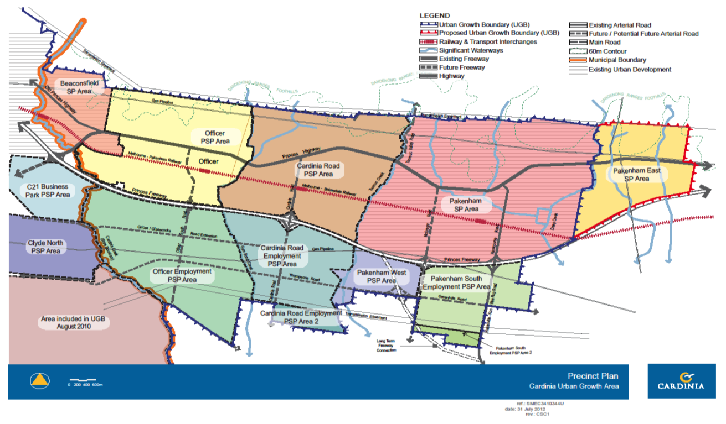
Strategic and Economic Development – Growth Areas
Cardinia Urban Growth Area Precinct Plan

Slide 42
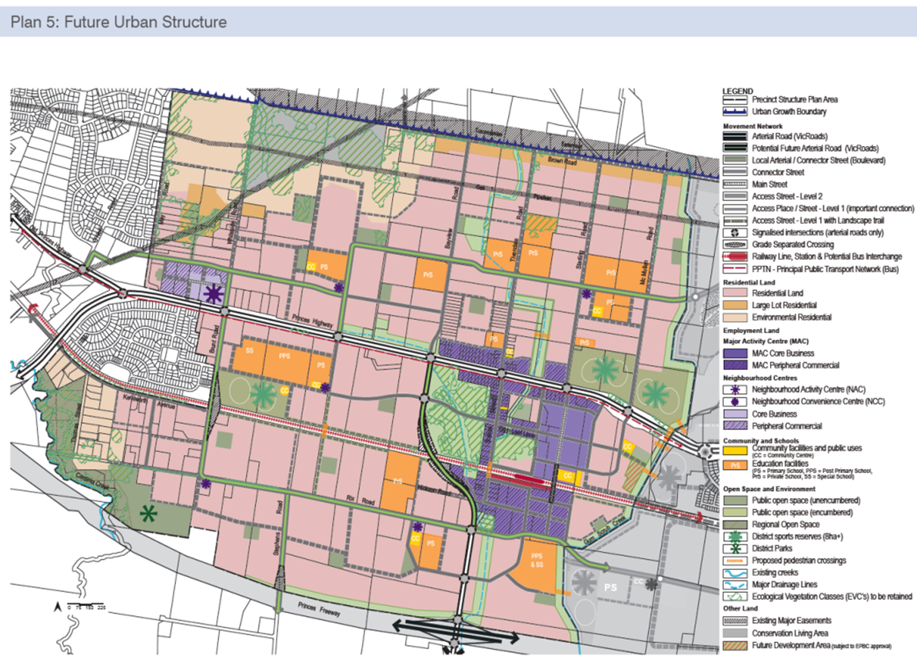
Precinct structure plan

Slide 43
Precinct Structure Plan
Council in conjunction with the Victorian Planning Authority (VPA), is responsible for preparing precinct structure plan (PSP’s).
A PSP sets the future structure for the suburb. It provides more detail on the land uses defined by the Growth Area Framework Plan.
It shows:
Housing yields
Employment land provision and location
Transport networks
Open space and natural systems
Activity centres
Community facilities

Slide 44
Precinct Structure Plan
They also include a Development Contributions Plan (DCP) or Infrastructure Contributions Plan (ICP) that determines how new infrastructure items such as roads and community centres are to be funded by each landowner.
Current approved PSP’s in Cardinia include:
Officer PSP (10,900 dwellings, 28,500 residents)
Cardinia Rd PSP (9,000 dwellings , 27,600 residents)
Cardinia Rd Employment PSP (18,000 jobs ,2000 dwellings,4200 residents)
Council is currently preparing:
Pakenham East PSP (6,000 dwellings, 16,000 residents)
Pakenham South Employment PSP

Slide 45
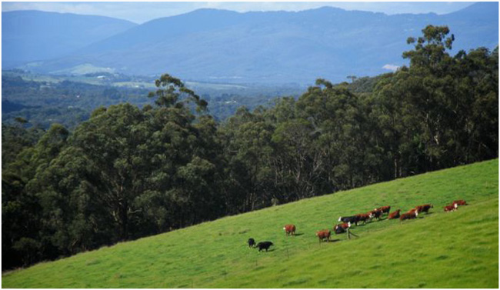
Rural township strategies
Emerald
Cockatoo
Gembrook
Garfield
Bunyip
Koo Wee Rup
Lang Lang
Upper Beaconsfield

Slide 46
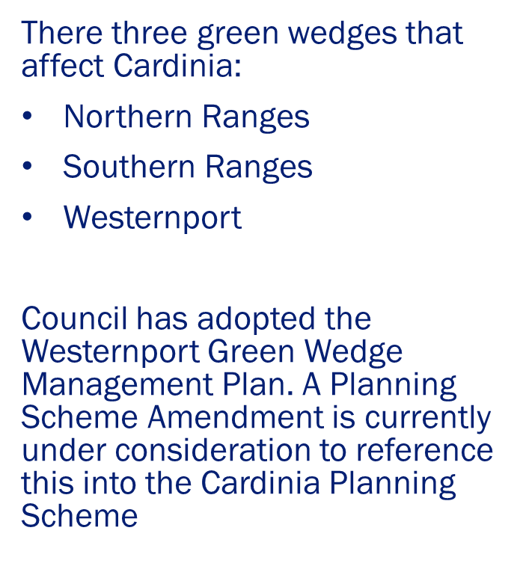
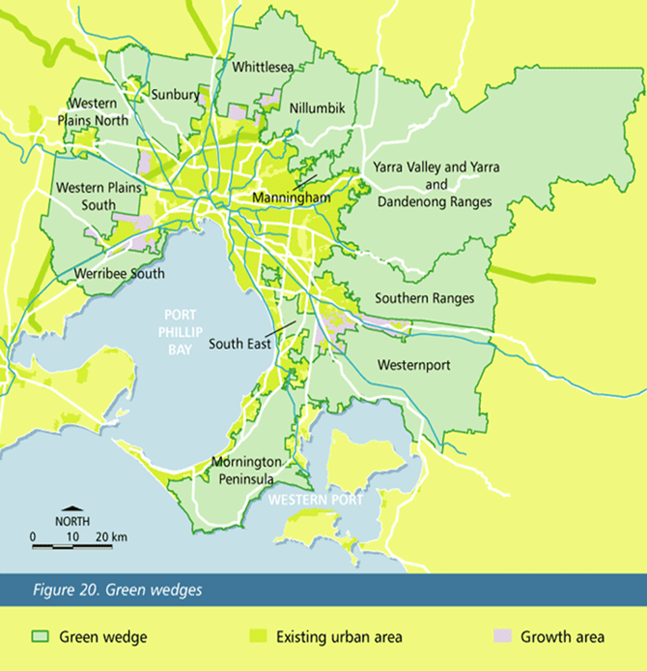
Green wedges

Slide 47
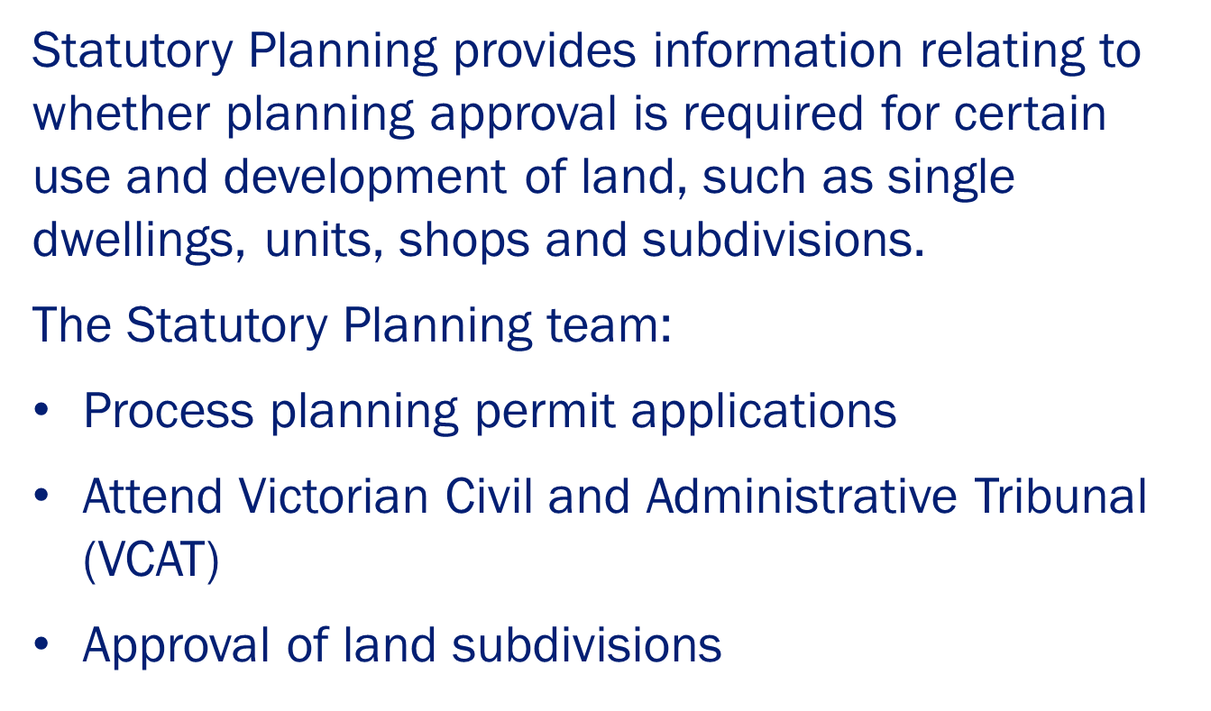
Statutory Planning

Slide 48
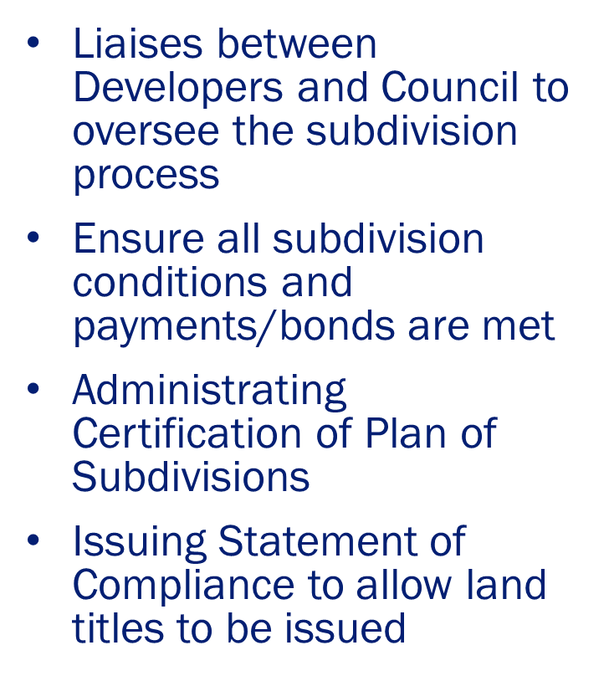
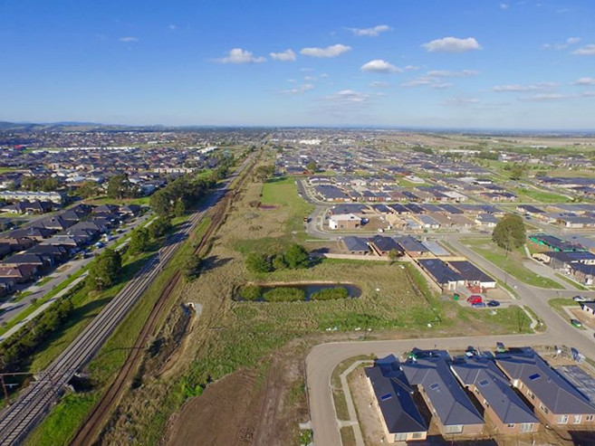
Subdivisions

Slide 49
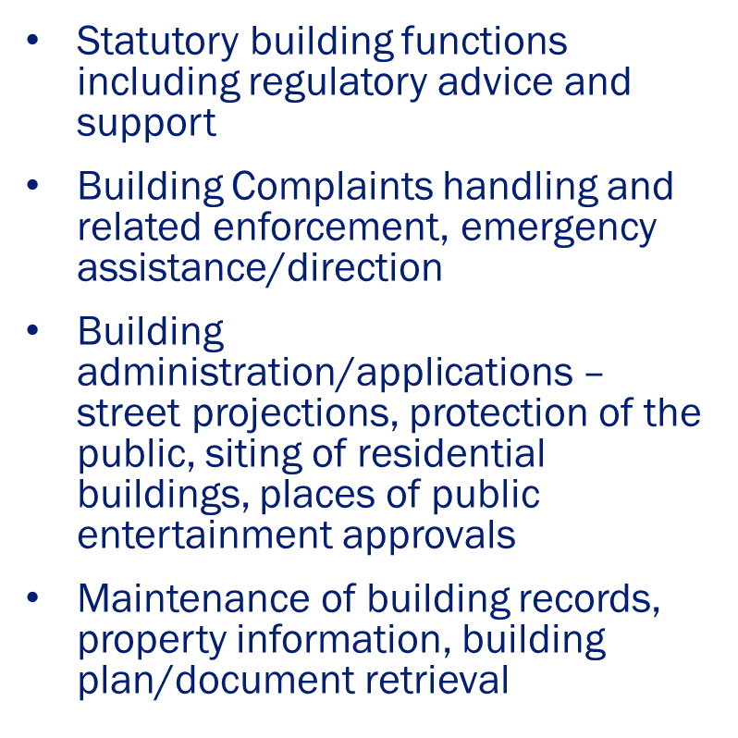

Building

Slide 50
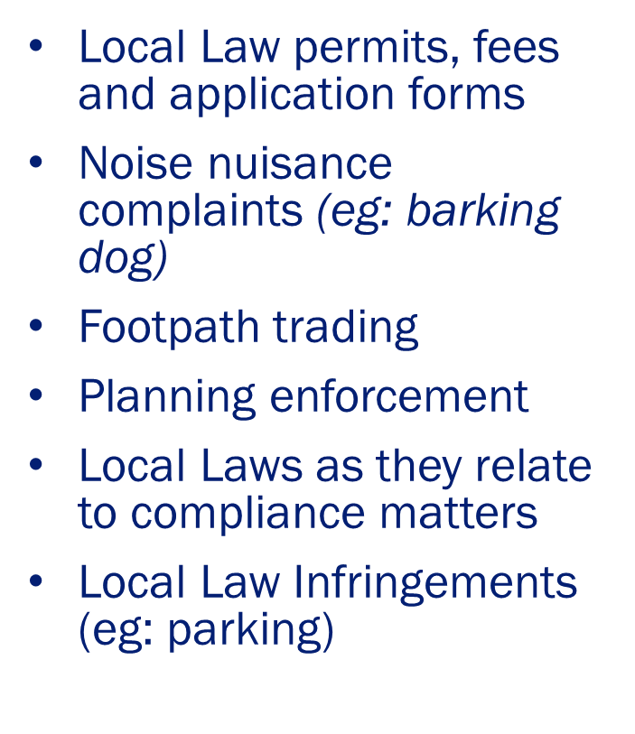

Compliance

Slide 51
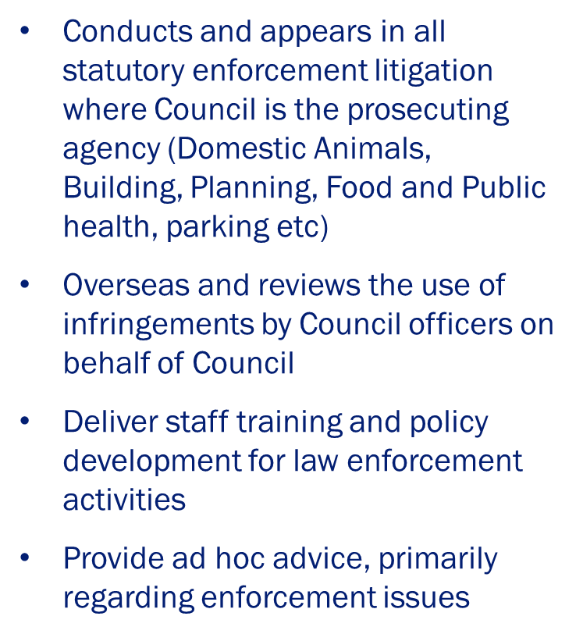

Prosecutions

Slide 52
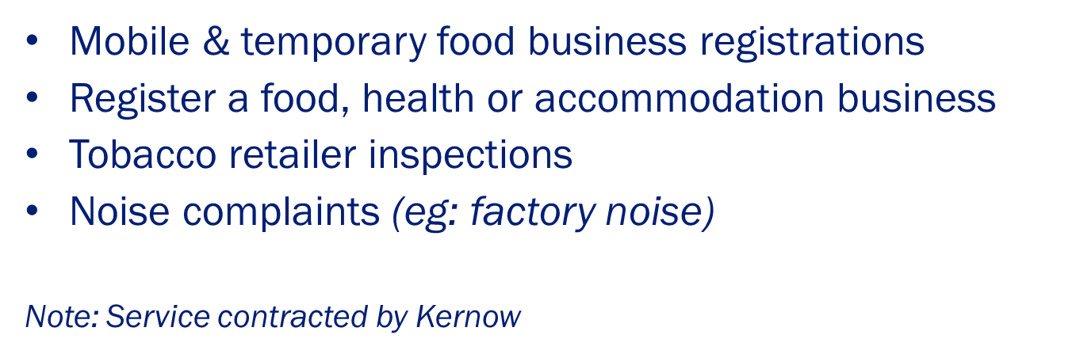

Environmental health

Slide 53
Assets and Services
Notes:
Thank you
My name is Andrew Barr and I am currently acting GM for Assets & Services whilst Mike Ellis is away on leave.

Slide 54
Asset Inventory - Snapshot
Asset Group | Measurement
Sealed Roads | 664km
Unsealed Roads | 863 km
Pathways (sealed and unsealed) | 628 km
Pedestrian Bridges | 54
Vehicular Bridges and Major Culverts | 170
Underground Drainage Pipes | 721 km
Drainage Pits | 26,433
Parks, Reserves and Bushland | 1,219 ha
Playgrounds | 98
Council Buildings | 232 (Council owned)
 | 54 (Maintained by Council but located on Crown (local) reserves)
Notes:
Firstly to set the scene, I would like to touch on what Cardinia’s asset base is.

Slide 55
Asset Management
Asset Management Plans (AMP) track the lifecycle of major asset groups over 30 years
AMP’s developed for Roads, Drainage, Bridges, Footpaths, Buildings and Open Space
AMP used to develop
the asset renewal programs

Slide 56
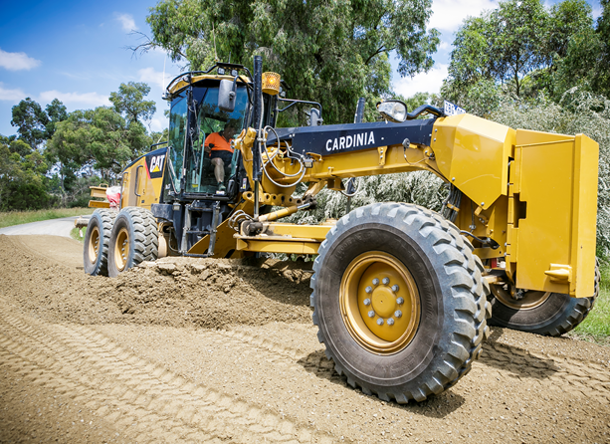
Average costs to maintain assets
Sealed roads - $1,500 per kilometre
  Pothole patching
  Shoulder maintenance
  Major failures
Unsealed roads
- $3,700 per kilometre
  Grading
  Dust control
  Minor re-sheeting
Notes:
The next few slides are here to inform you on the rising costs in maintaining such asset group.

Slide 57
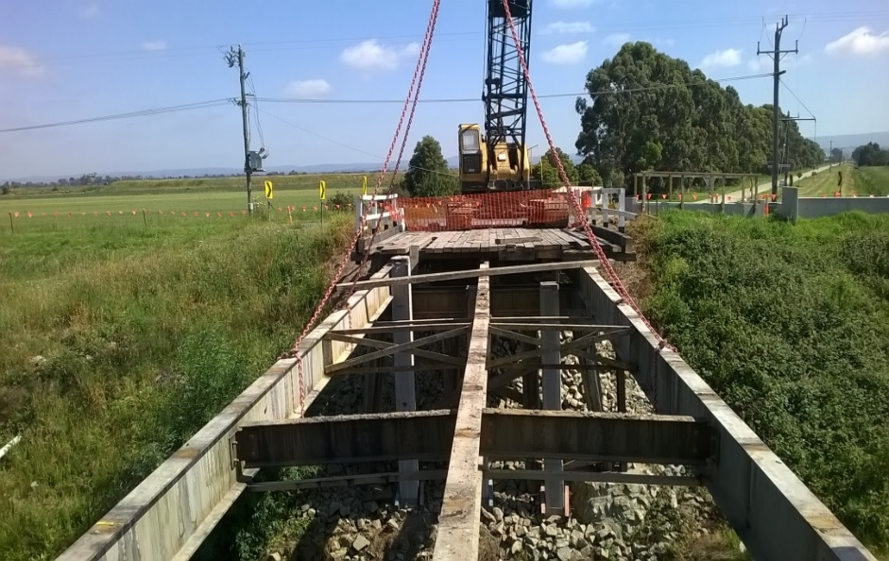
Average costs to maintain assets
Bridges & major culverts - $1,100 per structure
  Decking, handrails, safety fences
Underground drainage - $900 per kilometre
  Minor culverts, pipe and pit cleansing

Slide 58
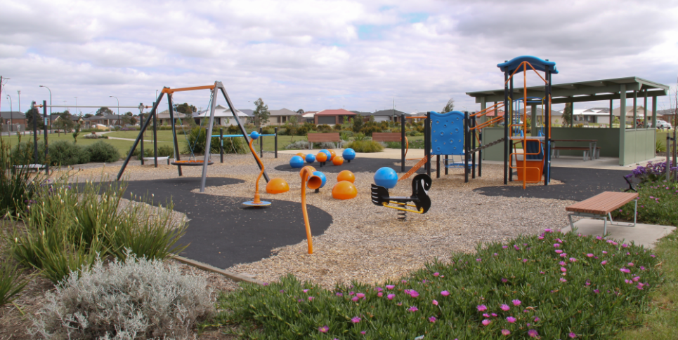
Average costs to maintain assets
Open space - $2700 per Hectare
  Grass mowing
  Tree & vegetation management
  Waterbody management
Playgrounds – $500 per playground
  Replacement parts
Notes:
Along with a host of other activities that our providers deliver as part of the Open Space Contract

Slide 59
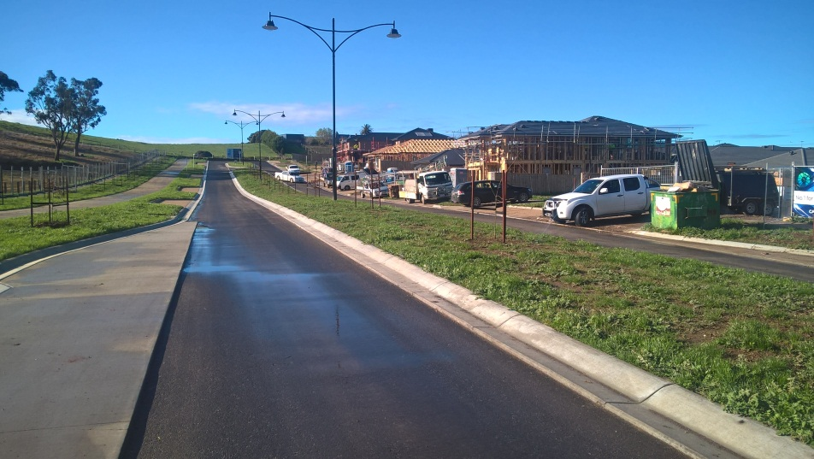
Costs to renew assets
Sealed roads resurfacing
  Asphalt overlay - $160,000 per kilometre
  Spray seal - $48,000 per kilometre
Unsealed road resurfacing
  $25,000 per kilometre
Playgrounds replacement
  $40,000 per unit
Pathways
  Concrete renewal - $150,000 per kilometre
Notes:
As part of Councils commitment to reduce the renewal gap, these costs reflect what it costs to renew/replace such asset groups

Slide 60
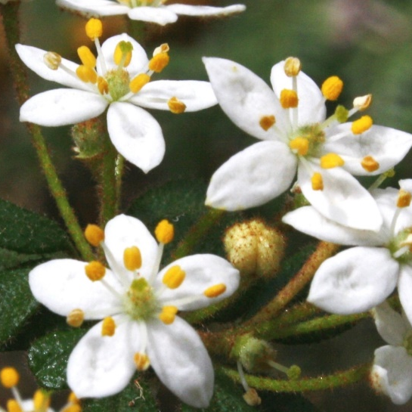
Environmental focus
Implementation of Council’s Integrated Water Management Plan
Completion of the Sustainably Environment Strategy
  Biodiversity
  Energy
  Climate Change
  Waste
  Water

Slide 61
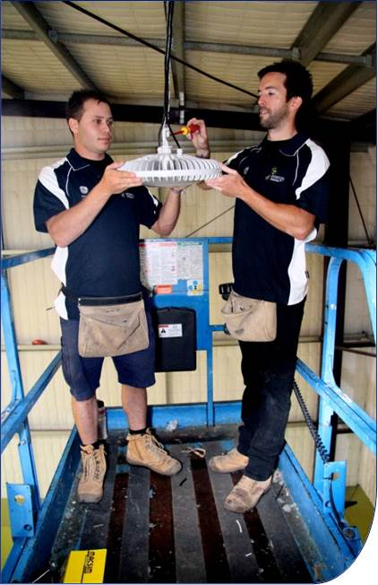
Environmental Goals
Climate change - Target for Cardinia to be carbon neutral by 2024.
Reduction of energy
consumption and carbon
emissions, works programmed
over the next five years
Notes:
Building lighting upgrades
Solar electricity system installations
decorative street lighting upgrade to energy efficient alternatives

Slide 62
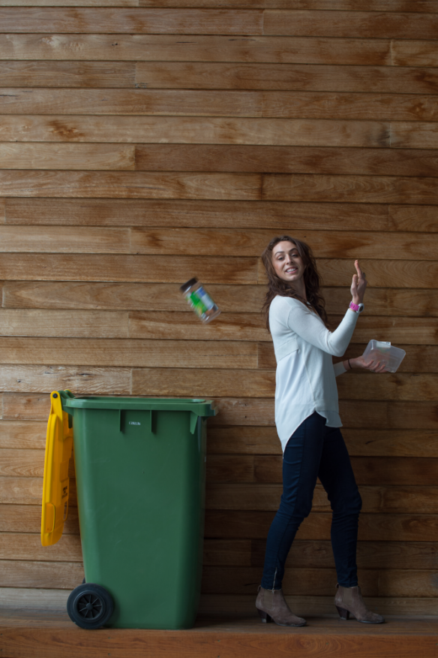
Waste Management
Deliver waste services: garbage, recycling, green waste, public place litter and recycling, hard waste, including ewaste
Waste education:
  integrated into service at schools
  and project based
Regional solutions for waste
  through Metro Waste Group
Notes:
Deliver waste services: garbage, recycling, green waste, public place litter and recycling, hard waste, including ewaste
Waste education – integrated into service at schools and project based
Develop regional solutions for waste processing and disposal – landfill, green waste, recycling opportunities through Metro Waste Group

Slide 63
Challenges facing Cardinia
Matching services for the growing population
  80 subdivision stages currently being assessed, constructed or in maintenance period (excluding planning stage)
  Providing timely and correct infrastructure
Notes:
Our growing population puts pressure on Council to keep up with approvals for and monitoring of subdivisions, delivering the infrastructure needed to live and work in these new areas as well as delivering waste services from the moment residents move in. The financial year we are looking at about 160 new properties coming on board every month.
Matching services for the growing population
80 subdivision stages currently being assessed, constructed or in maintenance period (excluding planning stage)
Providing timely and correct infrastructure (e.g. passive and active open spaces, community facilities, road & road related infrastructure, and traffic management, etc)
Planning for and providing adequate waste provisions and community education

Slide 64
Challenges facing Cardinia
Increase costs of amenity improvement services
  Impact on costs, amenity and environment
    Graffitti removal
      $150K approx. – 2015-16
    Dumped rubbish
      $190K approx. in 2015-16
    Street Sweeping
    Hard and green waste collections including e-waste, Detox Your Home and DrumMuster events - $1.4M for 2017/18
Notes:
The costs for Dumped Rubbish have increase by 500% since 2010. Delivering our Graffiti, Dumped Rubbish, Street sweeping and Hard Waste services are an important part of maintaining the place we live but costs are on the rise.

Slide 65
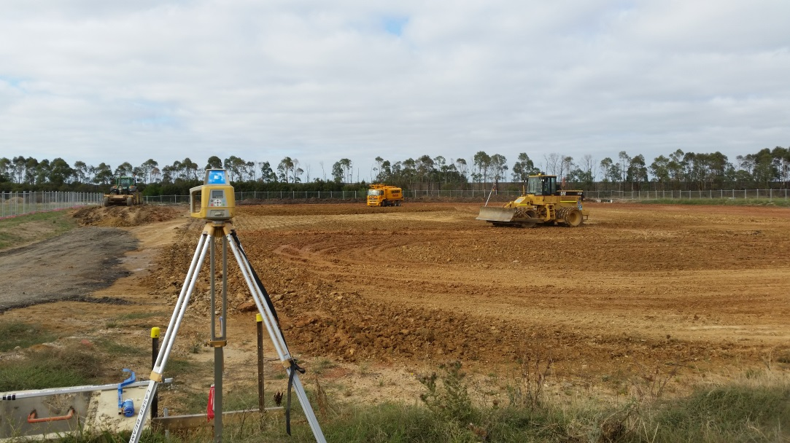
Capital Works Delivery
Children's Integrated Service Centres
Recreation facilities
Health Facilities
Road Construction
Bridge Replacement
Notes:
New projects totalling $Xm, including:
Commencement of the James Bathe Recreation Reserve (Total Project Budget $10.316m)
Commencement of the Cockatoo to Gembrook Trail
Continuation of Lang Lang Rec Reserve – Civil works ($6.1m)
Continuation of Deep Creek Eco Centre – Building and Civil Works (Total Project Budget of $10.325m)
New footpath construction ($850k)
Total expenditure of $Xm on asset renewal and upgrade, including roads, bridges and buildings, footpaths and drainage replacement, plant and plant replacement, recreation reserves and sporting facilities.

Slide 66
Community Wellbeing
Budget presentation

Slide 67
Community Wellbeing
Business Units
Active Communities
Community and Family Services
Community Strengthening

Slide 68
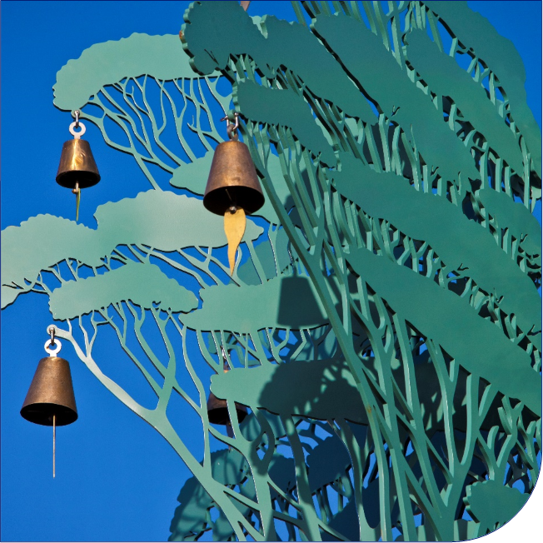
Active Communities
Arts and Culture
Arts & Culture Development
Planning for Arts & Culture
Public Art
Community development/events
Management of Cardinia Cultural Centre (CCC) and Pakenham Hall

Slide 69
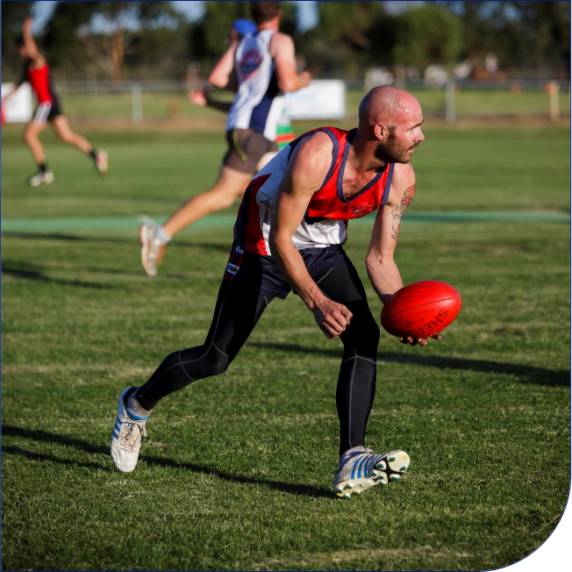
Active Communities
Recreation
Recreation planning and strategy development
Facilities contract management (Cardinia Life, Outdoor Pools & ELP, Pakenham Regional Tennis Centre, Officer Hub, Cockatoo Stadium)
Recreation Reserve Committee of Management support
Sports Development
Planning and stakeholder management for Recreation capital works.

Slide 70
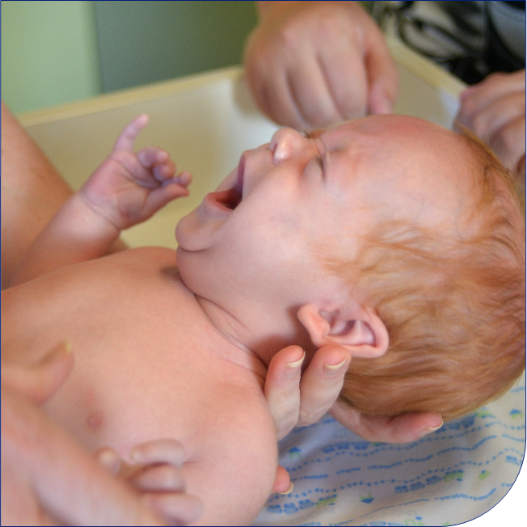
Community and Family Services
Maternal & Child Health
Initial home visits
Universal consultation services – key ages and stages
Enhanced support
Parent education

Slide 71
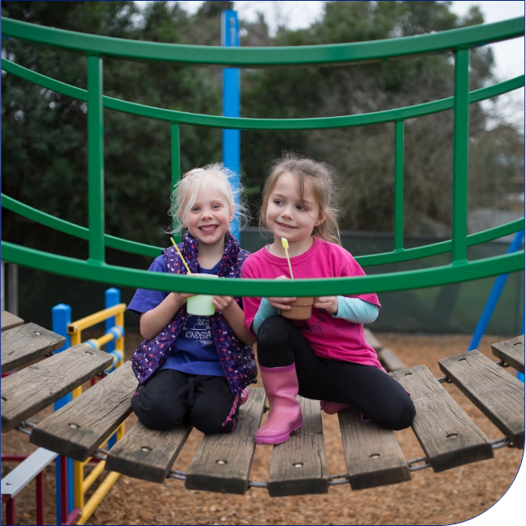
Community and Family Services
Children’s services
Best Start
Linking and Learning Initiative
Supported Playgroup facilitation
Pre-school Field Officer
Kindergarten Central Enrolment
Healthy and Active Children
Community Places

Slide 72
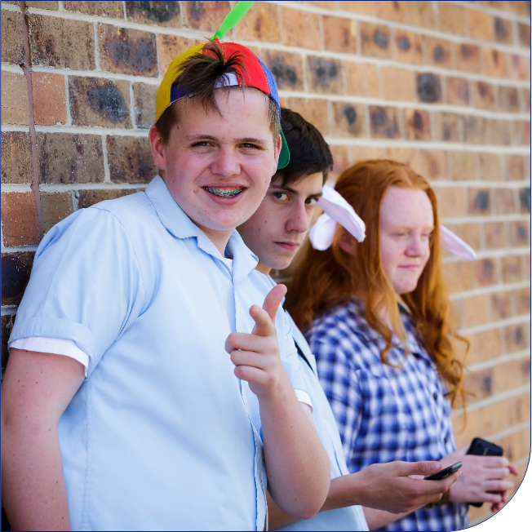
Community and Family Services
Youth services
Youth Outreach Program
My Place
FREEZA
Young Mums
GLBTI, Youth Support
In and out- of -school programs

Slide 73
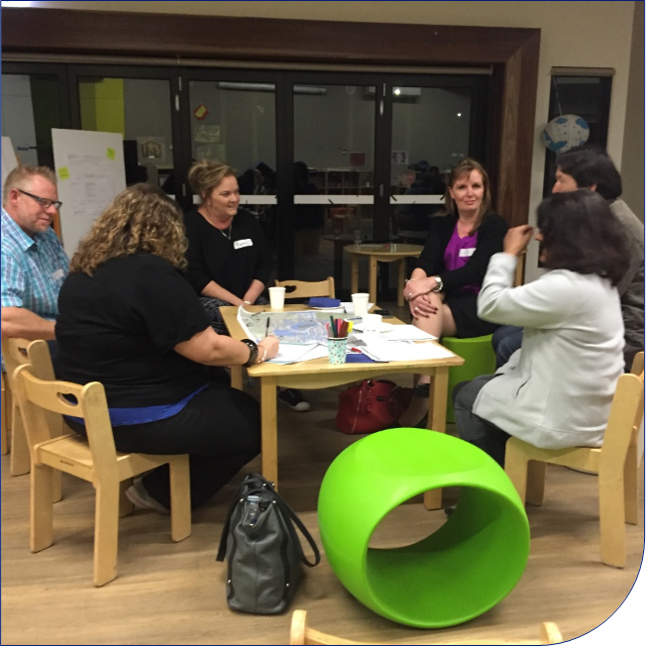
Community Strengthening
Community development
Facilitate and enable communities to be well connected to enhance their health & wellbeing. Includes:
Community engagement
Place based approach
Neighbourhood development
Awards: Australia Day, Stan Henwood, Volunteer
Community grants
Family violence
Community bus

Slide 74
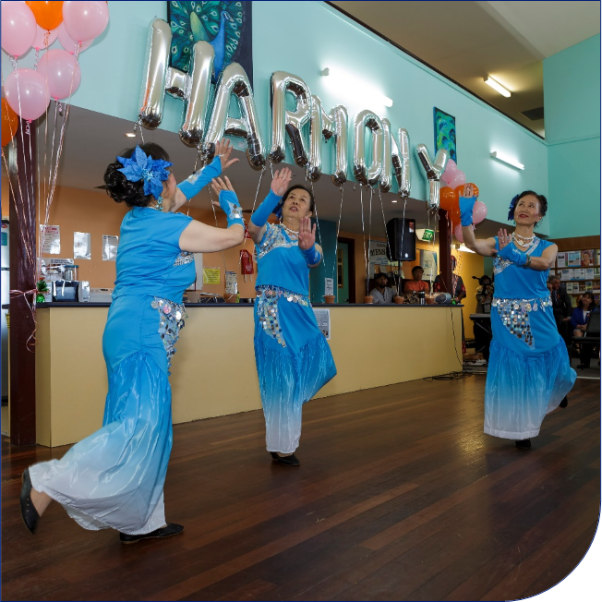
Community Strengthening
Safe and inclusive communities
Provide appropriate policies, strategies and activities to create a resilient, safe and inclusive community.
Includes:
Ageing well
Cultural diversity
Safer Communities
Access and Inclusion
Emergency Management

Slide 75
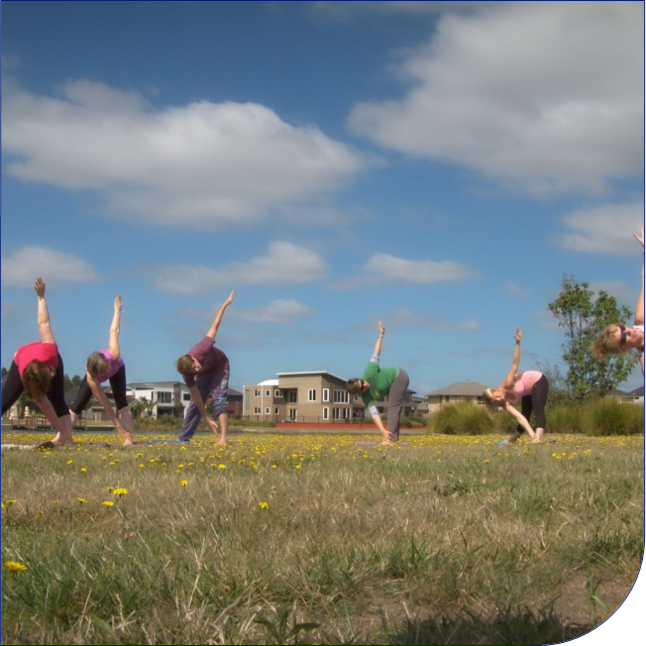
Community Strengthening
Social and community planning
Utilise and analyse data to ensure our community is well planned and liveable through a preventative response.
Includes:
Social planning
Community planning
Health and wellbeing planning
Affordable Housing
Food security

Slide 76
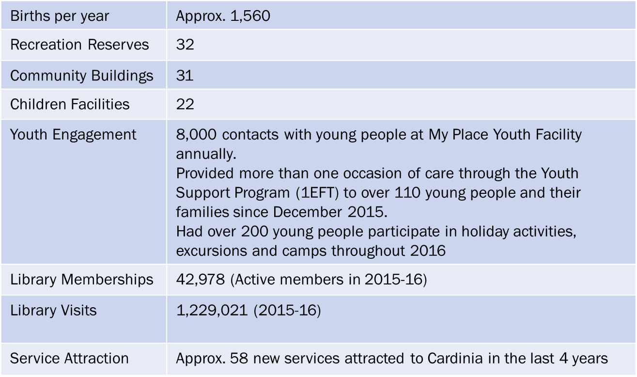
Data Snapshot

Slide 77
Challenges
Partnership, development and shared facilities agreements
Many services are externally funded
Poor social and health outcomes
Shallow market depth and service gaps
Service attraction
Cost shifting – libraries, MCH, Preschool field officer

Slide 78
Key actions for the next 12 months
New Liveability Health Plan
New Child ,Youth and Family Plan
Interface advocacy projects – service attraction
Together We Can Family Violence project
Food Circles – challenging obesity
Hills Hub

Slide 79
Key actions for the next 12 months
Capital Works projects including –
IYU project,
James Bathe Reserve,
Emerald Netball facility,
Worrell Reserve Oval reconstruction,
Lang Lang Community Sports precinct, Emerald to Gembrook multi use trail,
Comely Banks Reserve

Slide 80
Questions

