Slide 1
Festivals and Events Grants
Notes:
Introduce Toni and Myself
Acknowledgement of Country
Housekeeping – when to ask questions etc

Slide 2
Program Aims
Strengthen the events calendar with new and existing events whilst encouraging the growth, viability, sustainability and longevity of events.
Deliver high calibre events, which attract new audiences to the Cardinia Shire community, increasing visitation to the region.
Increase community and social connections and sense of belonging to increase participation and progress equity and inclusion.
Encourage and increase opportunities for all sections of the community to access, participate and appreciate arts and culture.
Notes:
Please ensure you have read through the new guidelines as they have changed.
Please remember to also attend the budget session next week. If you have not received a calendar invite pop it in the chat

Slide 3
Dates
The 2025-2026 Festival and Events grant program is for events which will be held between July 2025 and June 2026.
Grant applications for 2025-2026 will be open from Monday 14 April to Sunday 11 May at 11.59pm.

Slide 4
Categories
The Festival and Event Grant Program is split into three tiers of funding,
with grant amounts determined by the scope and capacity of the event.
Tier 1: Commercial festivals and events attracting significant impact and visitation
Tier 2: Community run events attracting moderate impact and visitation
Tier 3: Significant days of celebration attracting moderate impact and Civic pride

Slide 5
Tier 1 Funding
Estimated Attendance – Min 5000
Funding available - $10,000 - $80,000
Visitation – Min 50% out of region
Other revenue - 100% of funding requested by the applicant must be able to be matched via other revenue streams (ticket sales, sponsorship, other grants, applicant contribution etc.)
Business / community engagement - Must partner with local community groups and businesses in some way (i.e. using them as suppliers, marketing support, event day activations or involvement)
Council Engagement:
Prominent placement of Council’s logo on all promotional material preceded by the text “proudly presented by”
Invitation for Mayor and/or Councillor involvement (speeches, meet and greet community, photos, etc.)
Opportunity for Council to provide signage and branding
Opportunity for tickets to be used as part of competitions and giveaways, if a ticketed event

Slide 6
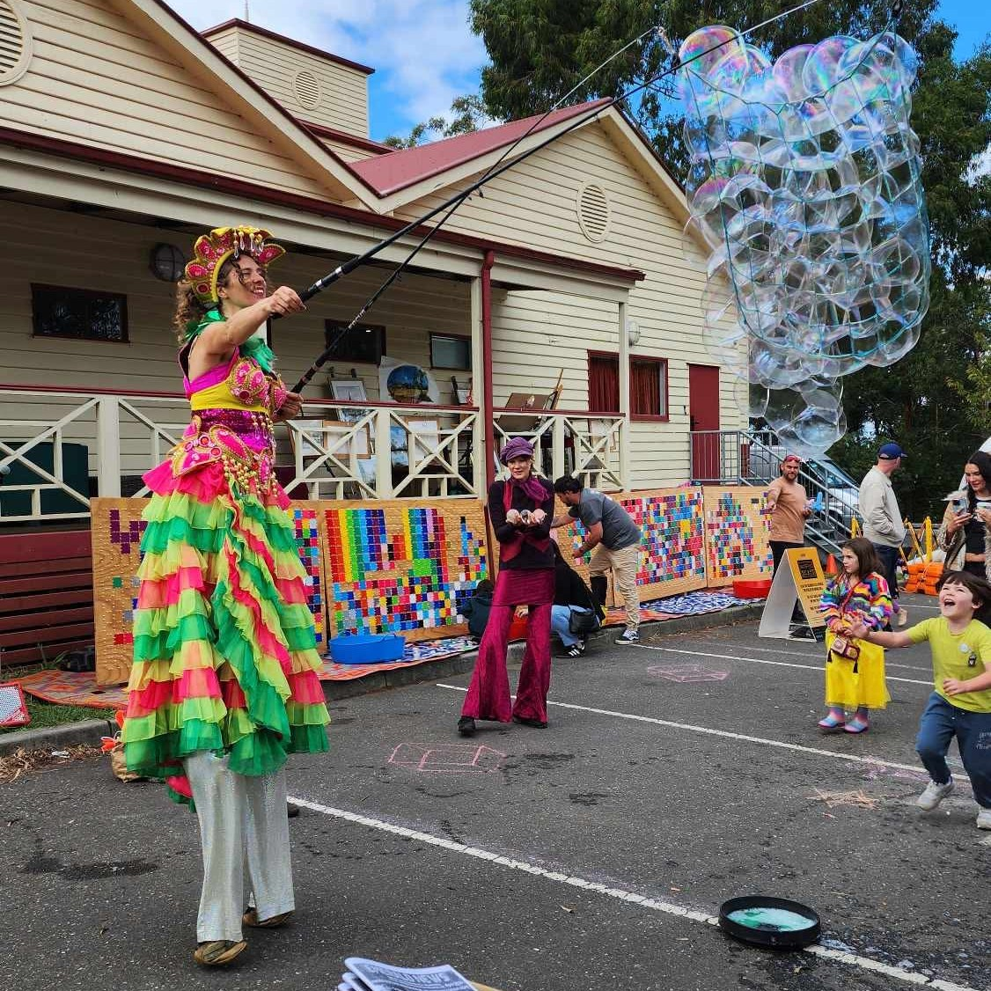
Tier 1 Example
Likely to be a multi-day event such as a festival.
Lots of infrastructure – marquees, traffic management, security, waste, first aid and emergency management, volunteers, equipment hire.
Example, Paved Festival:
10 day community festival
Multiple locations across region
Music, workshops, food, entertainment, markets, street fiesta
Over 10,000 in attendance over the course of the ten days

Slide 7
Tier 2 Funding
Estimated Attendance – Min 3,000
Funding available - $2,500 - $15,000
Visitation – Min 20% out of region
Other revenue - 80% of funding requested by the applicant must be able to be matched via other revenue streams (ticket sales, sponsorship, other grants, applicant contribution etc.)
Business / community engagement - Encouraged to partner with local community groups and businesses in some way (i.e. using them as suppliers, marketing support, event day activations or involvement)
Council Engagement:
Prominent placement of Council’s logo on all promotional material preceded by the text “proudly presented by”
Invitation for Mayor and/or Councillor involvement (speeches, meet and greet community, photos, etc.)
Opportunity for Council to provide signage and branding
Opportunity for tickets to be used as part of competitions and giveaways, if a ticketed event

Slide 8
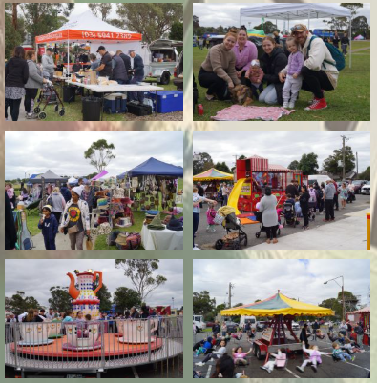
Tier 2 Example
Likely to be a single or two day event
Large celebratory event
Likely to require: Road closures, volunteers, waste management, emergency management
Example, Yakkerboo Festival
Evening and day event
Food trucks, entertainment, market, music, fireworks
Broad community and external reach

Slide 9
Tier 3 Funding
Estimated Attendance – Min 200 (or by negotiation)
Funding available - $1,000 - $5,000
Visitation – Local attendees
Other revenue - 50% of funding requested by the applicant must be able to be matched via other revenue streams (ticket sales, sponsorship, other grants, in-kind volunteer hours, applicant contribution etc.)
Business / community engagement - Desirable to partner with local community groups and businesses in some way (i.e. using them as suppliers, marketing support, event day activations or involvement)
Council Engagement:
Council’s logo on promotional material preceded by the text “proudly supported by”
Invitation for Mayor and/or Councillor involvement (speeches, meet and greet community, photos, etc.)
Opportunity for Council to provide signage and branding

Slide 10
Tier 3 Example
Small community events
Single or part-day events
Special holiday celebrations
Tier 3 example: Pakenham Hills Neighbour Day:
Single day event to celebrate National Neighbour day
Kids entertainment
Music
Health and fitness activities
Strong local community focus

Slide 11
Assessment Criteria
All applications will be assessed against the following criteria:
Program Objectives
Capacity and capability
Economic impact, social and community connections
Demand and relevance
Funding requirements and budget
Notes:
Program objectives
Applicants have demonstrated how their event meets the objectives of the program and supports the growth and expansion of Council’s events calendar.
• Applicants have shown how their attendance figures will meet the criteria specific to the tier they are applying for.
Capacity
Applicants have shown evidence of their expertise and capacity to successfully manage the proposed event (minimum two years), comply with Council and other authorities requirements and permits, provide a sufficient lead time to plan, deliver and promote the proposed event.
Applicants have a positive track record of delivering similar types of events successfully. There is a clear measure of what success looks like within the application.
Eco impact
• Applicants have demonstrated how their proposed event will engage with local businesses and community groups.
• Applicants have demonstrated how the event will celebrate, attract, and engage the local community and wider community in attracting visitation to the region.
• Applicants have demonstrated how they will build ongoing beneficial partnerships within the community. Pact
Demand
Applicants have demonstrated the long-term sustainability and viability of the event, including the levels of innovation, creativity and change within the event to ensure longevity.
• The proposed event aligns with demand in the events calendar and has an appropriate fit within the community.
Funding
Applicants have shown the viability of their proposed event and have provided a realistic budget reflective of the scope and scale of the event, including required revenue streams in relation to the requested funding, to ensure the success of the event is not solely dependent on Council.
• Applicants have demonstrated how the requested grant amount will enhance their event offering and attract a wider audience.
• For events who have received funding in the past, applicants have demonstrated how the current proposed funding will increase the benefit.
• A full itemised budget for expenditure and income must be attached to your application.

Slide 12
Eligibility
Eligible applications must:
Take place within Cardinia Shire
Be open to the general community, without discrimination or restriction and be socially, economically and physically accessible.
Provide a level of financial contribution in addition to the requested grant funding to ensure ongoing viability and longevity of the event.
Go towards enhancing your event or offering.
Have public liability insurance to the value of $20 million dollars and be willing to list Cardinia Shire Council as an interested party.
Be submitted within the program dates, be complete and include all required information.
Provide a valid Australian Business Number (ABN) or be a registered Not-For-Profit, community group, community asset committee or organisation.
Funding may be requested for food items which contribute toward the event or festival as materials (ie sausages for a community event sausage sizzle). Also to specifically feed volunteers delivering the event or festival, only if it is not the primary funded item.

Slide 13
Ineligible
Applications which will not be funded:
Private event or function, or if the proposed event will be held for members of a business, club, or group exclusively.
Ongoing business or operations, including staff salaries, administration and project management costs.
Fundraising contributions, prize money or competitions.
Private or member catering.
If the event conflicts with CSC’s policies, including but not limited to, the Gambling Harm Prevention and Minimisation Policy.
Retrospective funding, where an event has already been held, or is scheduled to be held before or after the annual funding period.
Capital works or facility maintenance costs, including for the purchase of event infrastructure.
Educational event, school fete or school event.

Slide 14
Ineligible
Applications will not be funded if:
The applicant is in financial debt with Council or has not previously complied with grant conditions.
The applicant is already receiving funding from Council for the same event or part thereof in the proposed financial year.
The applicant is unable to meet the compliance and safety requirements of running the event.
The applicant is a staff member, Councillor or contractor of Cardinia Shire Council.

Slide 15
Other considerations
Council Livibility Plan
Permits and traffic management
Event waste management
Sustainability for future events
Notes:
Add to chat:
Our Liveability Plan - Cardinia Shire Council
Apply for an event permit - Cardinia Shire Council
Order bins or get a smaller household rubbish bin - Cardinia Shire Council

Slide 16
How to Apply
Applications can be made via the Smarty Grants online application and must be submitted by Sunday 11 May at 11.59pm.
Please ensure you attach all requested supporting documentation for your application.
Applications without all required supporting documentation will be deemed ineligible

Slide 17
Additional Support
General enquiries
If you have any questions in relation to the grant program or accessibility requirements, please contact the Cultural Development and Grants Officer on 03 5943 4936 or email arts@cardinia.vic.gov.au.
Smarty Grants technical assistance
Please note, SmartyGrants is an independently run platform, if you experience technical issues with the SmartyGrants system, please contact them directly via email service@smartygrants.com.au or by calling 03 9320 6888 (Monday to Friday, 9am-5pm).

Slide 18
Next session
The next information session will be held Tuesday 29 April at 7pm.
A recording of this session will be available shortly.

