Slide 1
Grant Budgets

Slide 2
Budget 101
Income:
Grants
Generated income (ticket sales, stall fees, etc)
Sponsorship (with or without advertising, reciprocal arrangements)
Fundraising
In-kind (income)
Volunteer hours
Donated goods/hires (venue usage, equipment, tables, chairs, etc)
Donated services (graphic design, marketing & promotion, photographer etc)

Slide 3
Budget 101
Expenditure:
Risk management (traffic, first aid, security, etc))
Site costs (toilets, water, signage, staging, etc)
Marketing and Promotion (posters, programs, social media, print media, radio adverts)
Administrative (insurance, licences, permits, evaluation)
Entertainment (artists, performers, technical staff, event design etc)

Slide 4
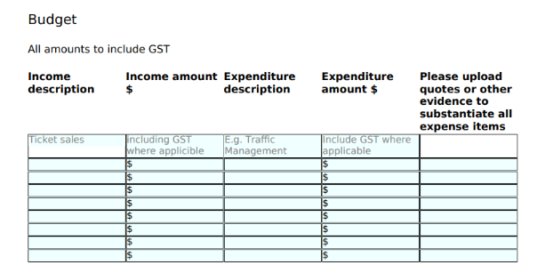
Smartygrants budget format

Slide 5
Working Budget
Example budget.xlsx

Slide 6
Multiple event applications
Provide the budget information as follows:
For complex budgets provide separate budgets (as per example budget) as support material
For simple budgets indicate Event (a) and Event (b) in expenditure
Provide budget notes for both events
Notes:
Program objectives
Applicants have demonstrated how their event meets the objectives of the program and supports the growth and expansion of Council’s events calendar.
• Applicants have shown how their attendance figures will meet the criteria specific to the tier they are applying for.
Capacity
Applicants have shown evidence of their expertise and capacity to successfully manage the proposed event (minimum two years), comply with Council and other authorities requirements and permits, provide a sufficient lead time to plan, deliver and promote the proposed event.
Applicants have a positive track record of delivering similar types of events successfully. There is a clear measure of what success looks like within the application.
Eco impact
• Applicants have demonstrated how their proposed event will engage with local businesses and community groups.
• Applicants have demonstrated how the event will celebrate, attract, and engage the local community and wider community in attracting visitation to the region.
• Applicants have demonstrated how they will build ongoing beneficial partnerships within the community. Pact
Demand
Applicants have demonstrated the long-term sustainability and viability of the event, including the levels of innovation, creativity and change within the event to ensure longevity.
• The proposed event aligns with demand in the events calendar and has an appropriate fit within the community.
Funding
Applicants have shown the viability of their proposed event and have provided a realistic budget reflective of the scope and scale of the event, including required revenue streams in relation to the requested funding, to ensure the success of the event is not solely dependent on Council.
• Applicants have demonstrated how the requested grant amount will enhance their event offering and attract a wider audience.
• For events who have received funding in the past, applicants have demonstrated how the current proposed funding will increase the benefit.
• A full itemised budget for expenditure and income must be attached to your application.

Slide 7
Budget evidence Tier 1 Funding
Estimated Attendance – Min 5000
Funding available - $10,000 - $80,000
Other revenue - 100% of funding requested by the applicant must be able to be matched via other revenue streams (ticket sales, sponsorship, other grants, applicant contribution etc.)
Business / community engagement - Must partner with local community groups and businesses in some way (i.e. using them as suppliers, marketing support, event day activations or involvement)

Slide 8
Budget Evidence Tier 2 Funding
Estimated Attendance – Min 3,000
Funding available - $2,500 - $15,000
Other revenue - 80% of funding requested by the applicant must be able to be matched via other revenue streams (ticket sales, sponsorship, other grants, applicant contribution etc.)
Business / community engagement - Encouraged to partner with local community groups and businesses in some way (i.e. using them as suppliers, marketing support, event day activations or involvement)

Slide 9
Budget Evidence Tier 3 Funding
Estimated Attendance – Min 200 (or by negotiation)
Funding available - $1,000 - $5,000
Other revenue - 50% of funding requested by the applicant must be able to be matched via other revenue streams (ticket sales, sponsorship, other grants, in-kind volunteer hours, applicant contribution etc.)
Business / community engagement - Desirable to partner with local community groups and businesses in some way (i.e. using them as suppliers, marketing support, event day activations or involvement)

Slide 10
Budget tips
Quotes, recent invoices, or email/letter agreement are all accepted as proof
Ticket sales: always budget for 35% of capacity as income
Include discounts as in kind support
If you borrow equipment or are provided a service free of charge that you do not know the cost of, provide an in kind income from a comparable company
In kind volunteer hour calculator www.vic.gov.au/grants-understanding-kind-contributions
Evaluation and documentation – make sure you budget for this
Pay artists and performers appropriate rates (see MEAA and NAVA)
MAKE SURE YOUR BUDGET REFLECTS YOUR PROJECT DESCRIPTION – if you way you are going to do something, but there is no budget line for it, it looks like poor planning. If you are getting it for free, then tell us.

Slide 11
Additional Support
General enquiries
If you have any questions in relation to the grant program or accessibility requirements, please contact the Cultural Development and Grants Officer on 03 5943 4936 or email arts@cardinia.vic.gov.au.
Smarty Grants technical assistance
Please note, SmartyGrants is an independently run platform, if you experience technical issues with the SmartyGrants system, please contact them directly via email service@smartygrants.com.au or by calling 03 9320 6888 (Monday to Friday, 9am-5pm).

