Slide 1
Community Bus
Etiquette and Hygiene Guidelines

Slide 2
Welcome to the Cardinia Community Bus
To ensure the continued safe enjoyment of the bus, we have put together a few guidelines to follow.

Slide 3
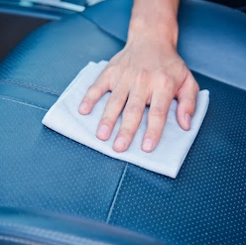
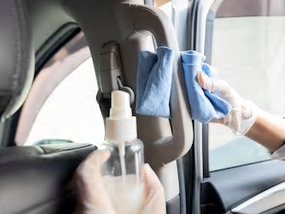
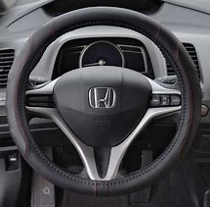
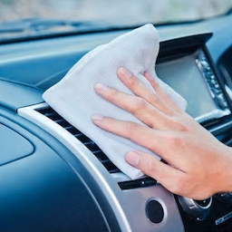
Keep it clean…
Using the cleaning products provided, before and after use, wipe down:
All seat surfaces
Internal and external door handles and grab rails
Steering wheel
All other contact surfaces

Slide 4


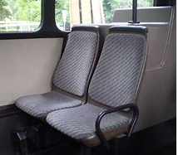

Personal hygiene
To protect yourself and others:
When coughing or sneezing, do so into your elbow
On entering and leaving the bus, please use the hand sanitiser provided
Limit seating to one person per row
Maintain a distance between passengers of at least 1.5 metres at all times
x

Slide 5
For more information regarding COVID-19 hygiene guidelines and current social distancing restrictions, please visit the government health alerts website.

